Slide 1


Molecular Tailoring of Interfaces using Self-Assembled Monolayers: A Multi-scale Study of Roughness Effects
Chen Zhang, Graduate Student
Aerospace Engineering
Amnaya P Awasthi, Post-doc
Aerospace Engineering
Nancy Sottos, Professor
Materials Science and Engineering
Martha E Grady, Graduate Student
Mechanical Engineering
Philippe Geubelle, Professor
Aerospace Engineering
University of Illinois at Urbana-Champaign, USA
Session: Mechanics of Thin Films and Multi-Layer Materials
SES 2014, Purdue University, West Lafayette, IN
October 1-3, 2014

Slide 2
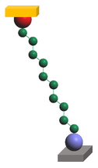
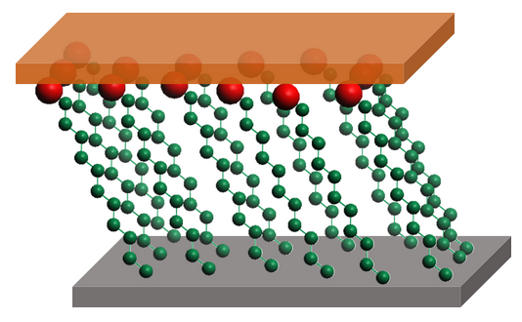
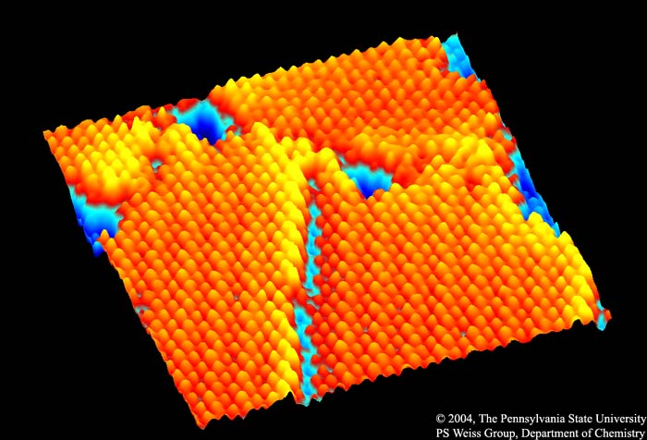
Self-Assembled Monolayers
Terminal groups
Ordered molecular assemblies formed spontaneously on surfaces by adsorption
Each unit comprises of the ‘head group’, ‘tail’ and ‘functional group’
Applications
Wetting and adhesion
Chemical resistance
Nano-fabrication
For studying membrane properties of cells
Commercial application example: Rain-X
Surface modifiers in MEMS and NEMS
Bio-compatibility
Thermal management of nano-electronics
Nanoscale tailoring of interfaces
Thin film
Substrate
SURFACE
MODIFIERS
INTERFACE
TAILORING
Scanning tunneling microscope image (15 nm x 15 nm) of a SAM of n-decanethiolate on Au{111} (Paul Weiss’ group, PSU)

Slide 3
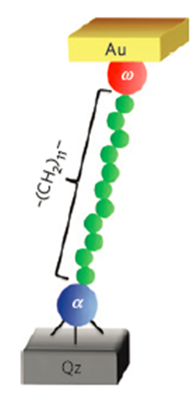
Molecular Mechanical Tailoring of Interfaces
In the literature…
Experiments: Impact of SAM on adhesion using quasi-static techniques (super-layer tests, DCB, …)
Example: Zhuk, Evans, Hutchinson and Whiteside, J. Mater. Research (1998): impact of COOH/CH3 functional groups on interface strength of epoxy film on Au/Ti/Si substrate
Review article: Goertz and Moore, Prog. Surf. Science (2010)
Modeling: Emphasis on constitutive properties of SAM
Example: Wang, Liechti, et al., J. App. Mech. (2006): Hybrid continuum-molecular analysis of constitutive response of OTS on Si/SiO₂
Objective: Investigate dynamic failure response of SAM using a combined experimental and modeling study
Atomistic modeling of ‘SAM-enhanced’ interfaces
Laser-based spallation experiments
Continuum (cohesive) modeling of effect of roughness
Losego et al., Nature Materials, 2012

Slide 4
Materials
Self-assembling molecules (Gelest Inc.)
Chemical | Formula | Shorthand Name
Dodecyltriethoxysilane | CH₃(CH₂)₁₁Si(OC₂H₅)₃ | DTES
11-mercapto-undecyltrimethoxysilane | SH(CH₂)₁₁Si(OC₂H₅)₃ | MUTMS
11-bromo-trimethoxysilane | Br(CH₂)₁₁Si(OC₂H₅)₃ | BrUTMS
11-amino-trimethoxysilane | NH₂(CH₂)₁₁Si(OC₂H₅)₃ | ATES
CH₃
SH
Br
NH₂
Mixed Monolayers
50% mole percent in solution
SiO₂ Substrate
Notes:
Also describe mixed monolayers here as well

Slide 5

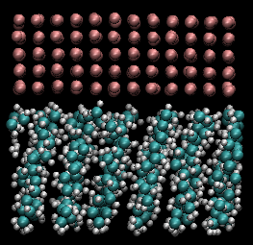
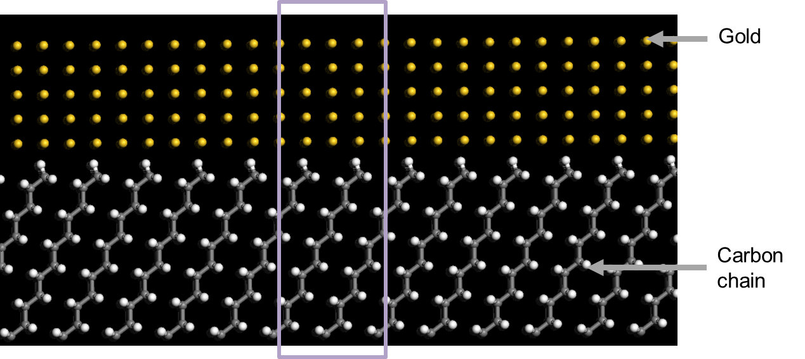
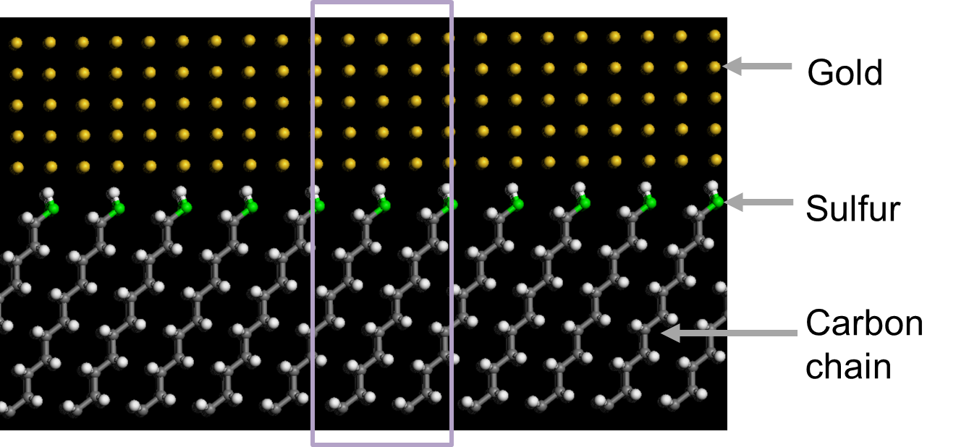
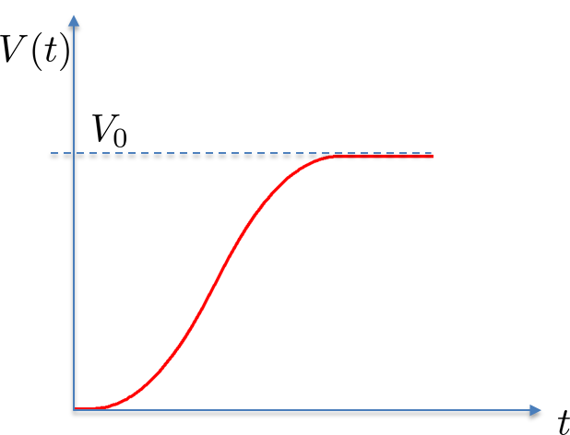
MD Model of DTES and MUTMS SAMs
Thermal equilibrium (at 300K) and spallation simulations performed using LAMMPS
MD analysis based on ReaxFF potential to model bond failure (Jarvi et al., J. Phys. Chem. A, 2011)
“Smooth” application of constant velocity along top Au atomic layers
SAM/Gold model built using Materials Studio
In-plane periodic unit cell of size 25A x 25A x 40A (Contains about 1500 atoms)
Captures SAM tilt with respect to Silica layer
Dodecyltriethoxysilane | CH₃(CH₂)₁₁Si(OC₂H₅)₃ | DTES
11-mercapto-undecyltrimethoxysilane | SH(CH₂)₁₁Si(OC₂H₅)₃ | MUTMS
Velocity imposed on gold layer

Slide 6
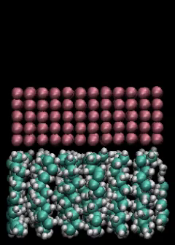
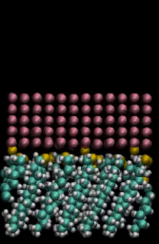
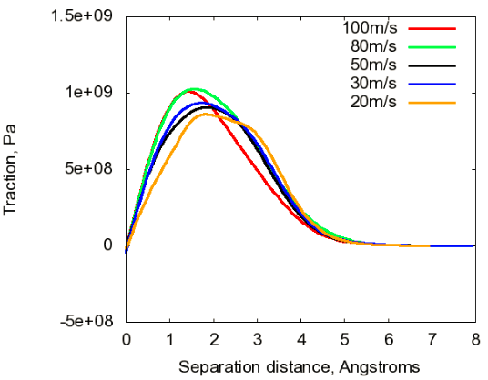
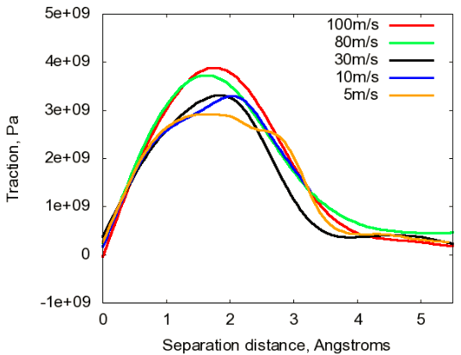
MD Predicted Cohesive Laws for DTES, MUTMS
DTES
MUTMS
T=300K, V₀=30m/s,
strain rate = 4x10¹⁰ s⁻¹
Work of separation ~ 0.3 J/m²
Interfacial strength ~ 0.75 GPa
Work of separation ~ 0.6 J/m²
Interfacial strength ~ 3 GPa

Slide 7
SAM Functionalization Procedure
SAM bath
24 hours
SAM molecule, amine catalyst, toluene
Rinse Toluene, Ethanol,
DI water,
blown dry
Piranha Solution
Clean
Transfer Printing
“Soft” lithography process
Material Characterization
Technique
Information Acquired
Ellipsometry
SAM layer thickness ~ 1 nm
Atomic Force Microscopy (AFM)
Surface topography, surface roughness
X-ray Photoelectron Spectroscopy (XPS)
Chemical information

Slide 8
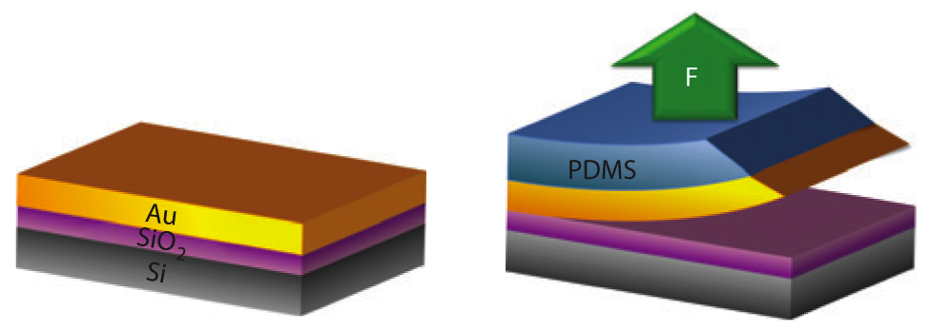
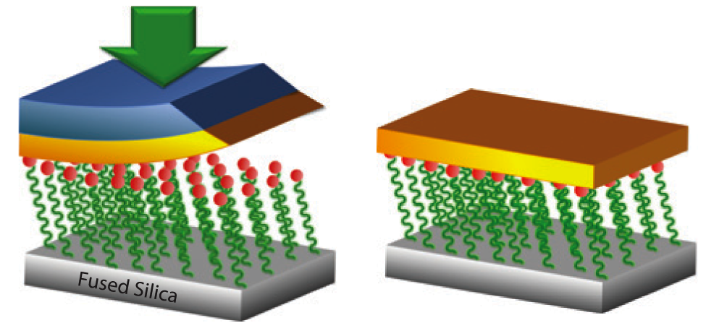
Transfer Printing Method
1
Deposit Au on donor substrate
2
Use PDMS stamp to peel off gold
3
Transfer Print to New Substrate
4
Peel off PDMS
SiO₂/SAM/Au
Losego et al. Nat. Mater. 11 (2012)

Slide 9
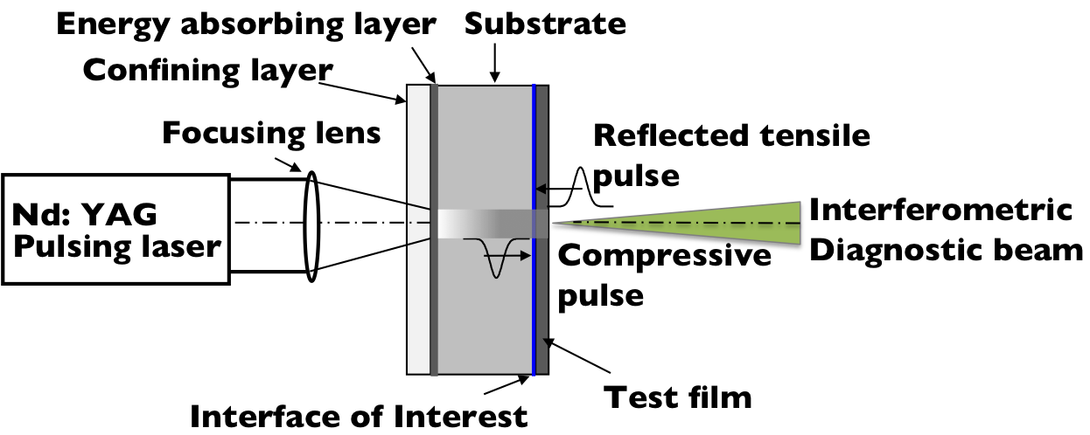
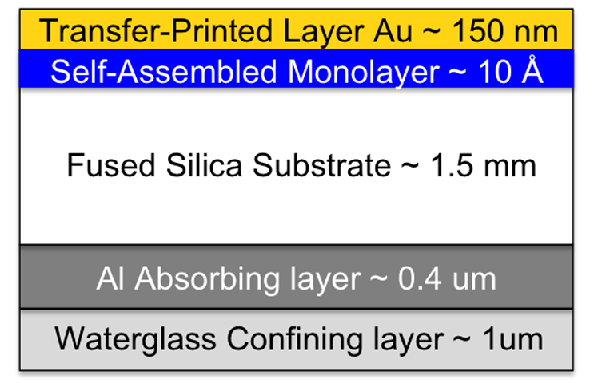
Interfacial Strength Measurement
Laser Spallation Technique
Specimen Schematic
Transfer printed Au films (150 nm)
Fused silica / Si substrates (1.5 mm thick)
Nd:YAG spot size of 2.0 mm
Test over a range of fluences
Determine film failure optically

Slide 10
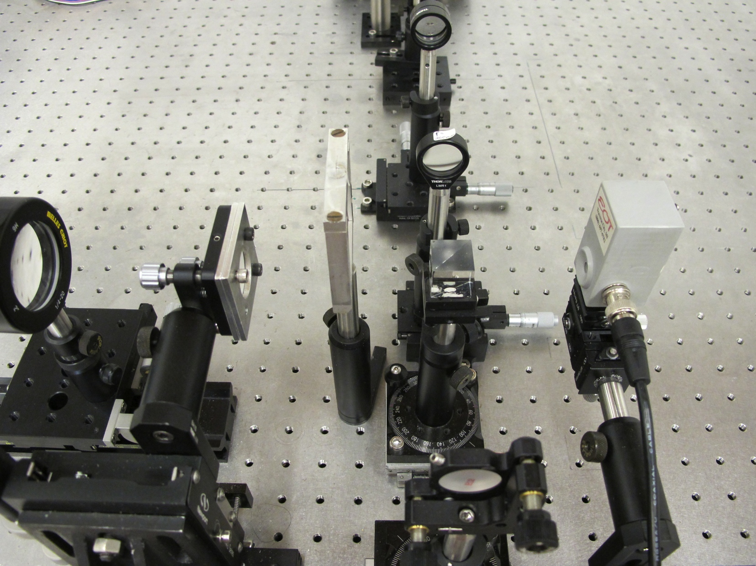
Laser Spallation Setup
Nd:YAG focusing lens
Nd:YAG filter
photodiode detector
beam splitting cube
sample holder
film
specimen
mirror
to
oscillo-scope
Grady et al. Thin Solid Films (2013)

Slide 11
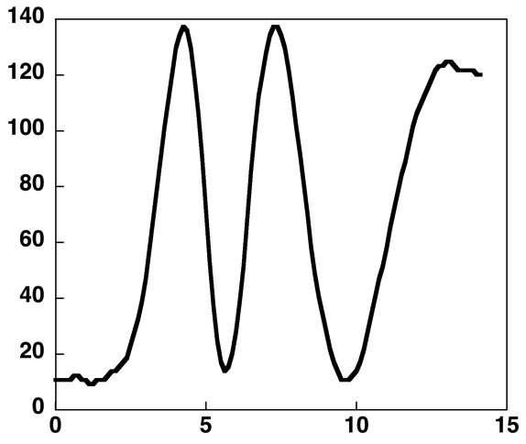
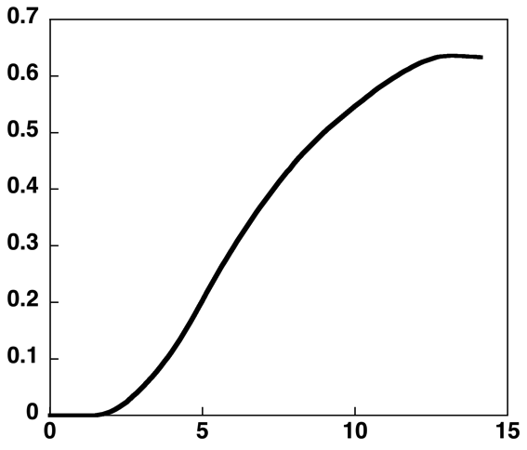
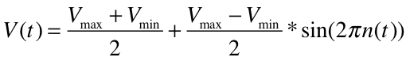
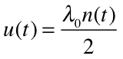
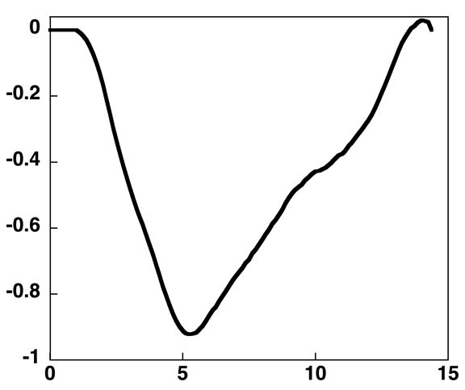
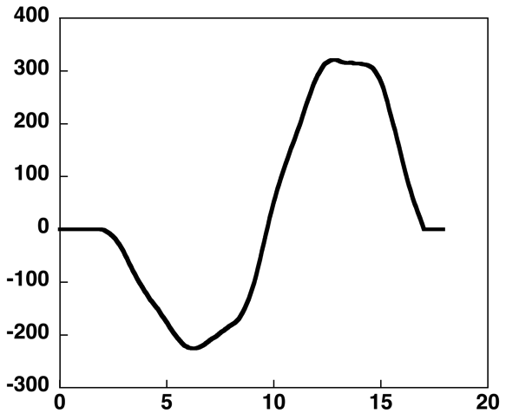
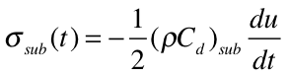
Interferometric Data Analysis
Output Voltage Signal
Displacement
Voltage (mV)
Dispalcement (μm)
Time (ns)
Time (ns)
Substrate Stress Pulse
Interface Stress
Substrate Stress (GPa)
Interface Stress (MPa)
Time (ns)
Time (ns)
Results from 1D Finite Element Model
Notes:
Lev and Argon studied geometric attenuation….negligible, minimal losses for 3-4 times radius of spot.
Barker 1972 experimental mechanics laser interferometry in shockwave research
Elastic wave equation slide 74, Junlan has nice derivation in JMPS paper

Slide 12
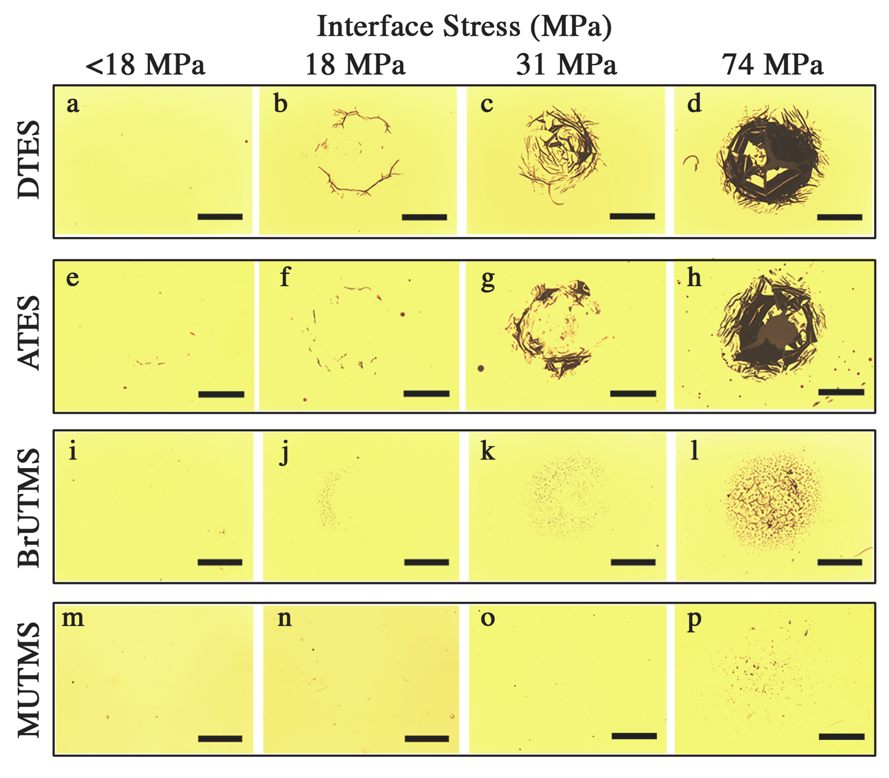
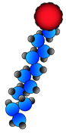
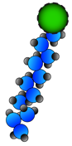
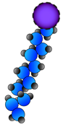
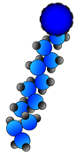
Observed Film Failure
Increasing
Interfacial Strength
-CH₃
-NH₂
-Br
-SH
all scale bars are 500 μm
Notes:
Transition into mixed monolayers

Slide 13
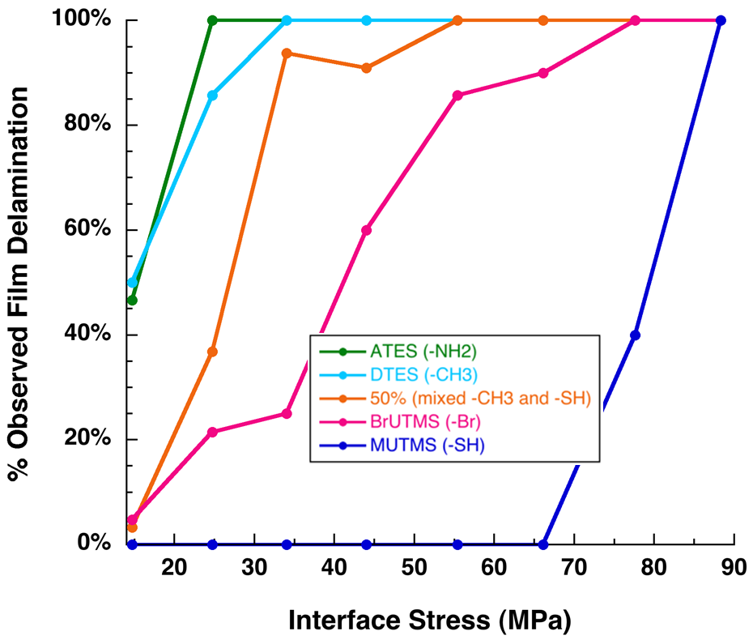
Interfacial Strength Statistics
Interface strength determined at interface stress that initiates film failure in >85% tests
DTES
MUTMS
Experimental | Numerical
25 MPa | 0.75 GPa
85 MPa | 3 GPa
DTES
MUTMS
Measured interfacial strength much lower than MD predictions

Slide 14
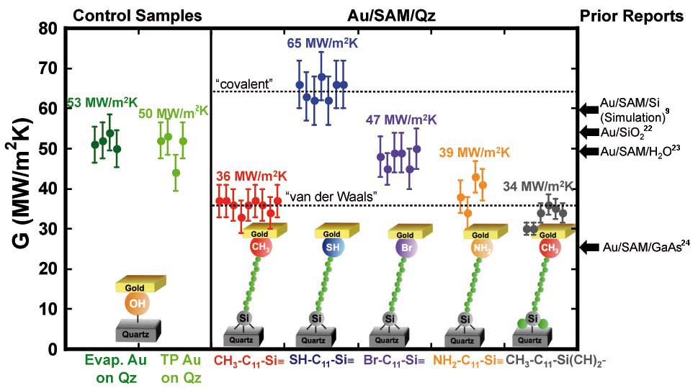
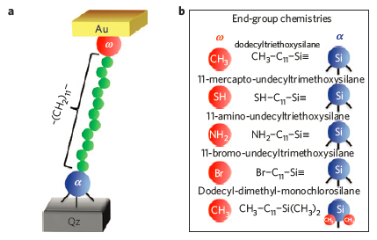
“Side Note”: Heat Transport Properties
Losego et al. Nature Materials. 2012.
Thermal conductance G=Q/ΔT measured using time-domain thermo-reflectance
SAM between quartz and gold film
Strong correlation between G and bond strength
Notes:
TDTR is a modulated optical pump-probe technique that uses a pulsed Ti:sapphire laser to monitor temperature decay by thermoreflectance with picosecond resolution.

Slide 15
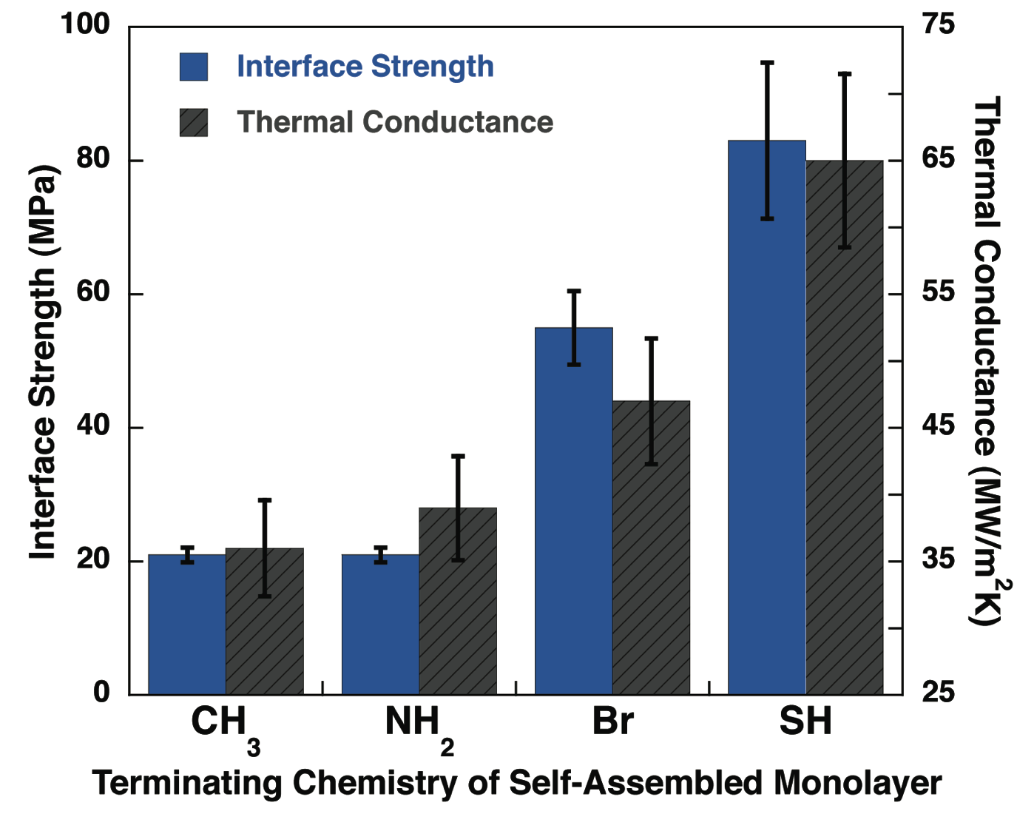
Interface Strength vs. Heat Transport
**
Strong correlation with thermal conductance
Effectively tune both properties with single monolayer
** Error estimated at ±5% TDTR Measurements appear in Losego et al. Nature Materials, 11, 502-506, (2012)
Notes:
----- Meeting Notes (9/26/13 16:41) -----
Discrete bars for the thermal plot

Slide 16
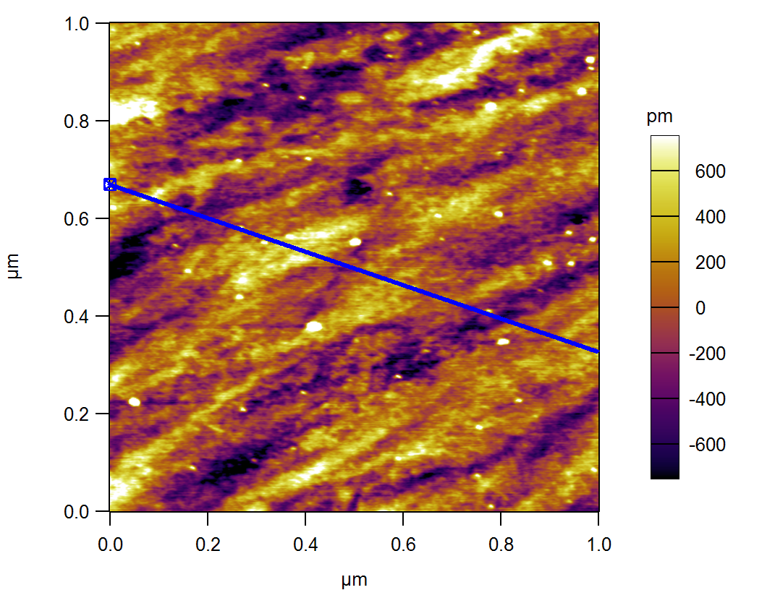
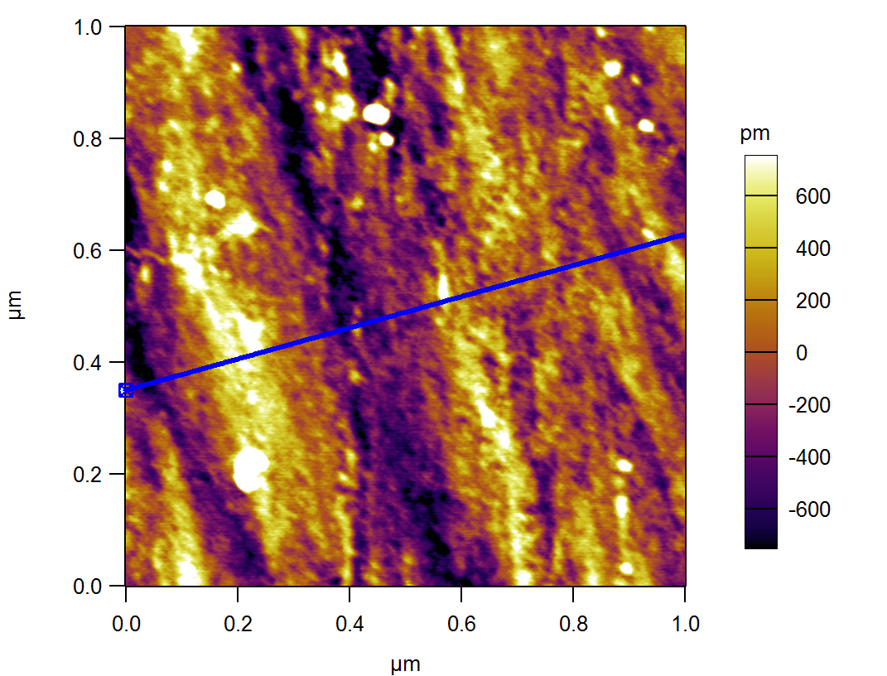
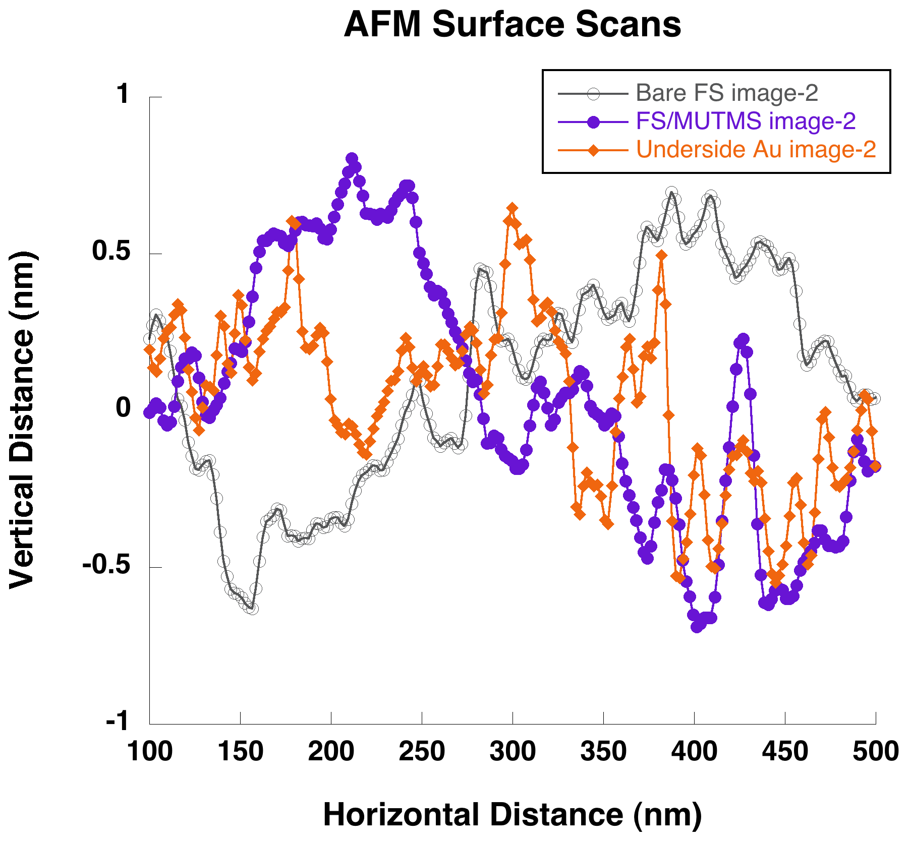
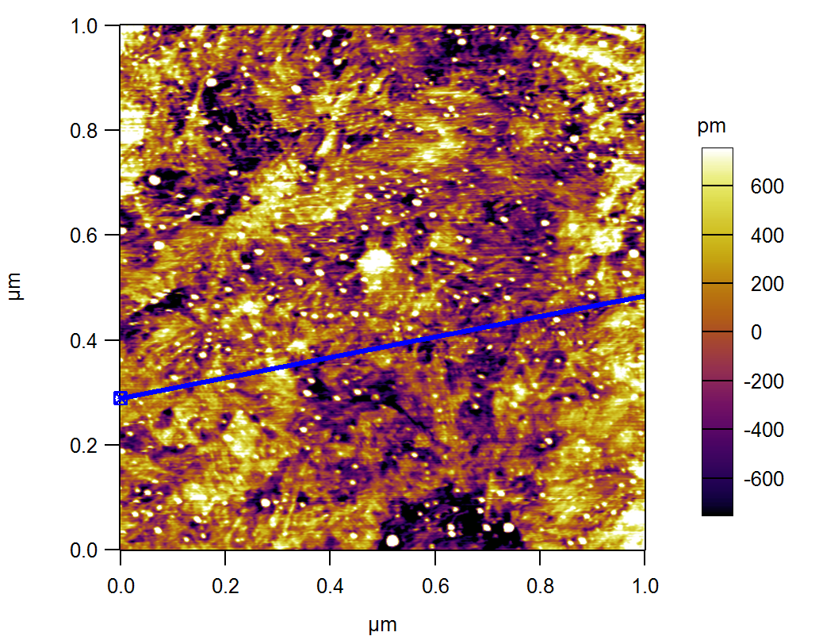
Back to Interface Strength: AFM Surface Scans
Bare FS
FS/MUTMS
Underside of Au
All image scale bars have range of 1.5 nm
Scan in graph above indicated on green highlighted portion of image
Surface roughness of SAM comparable to SAM thickness

Slide 17
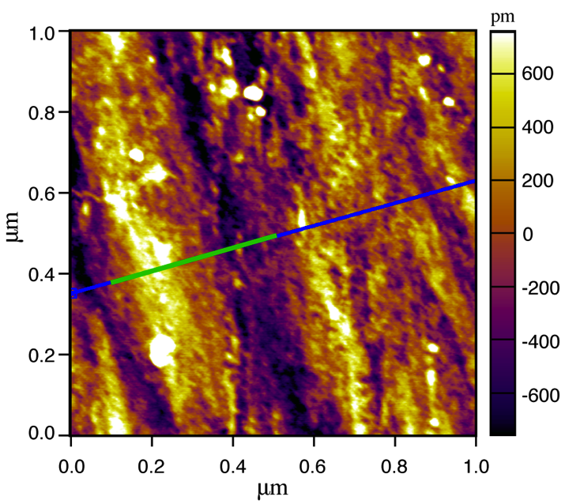
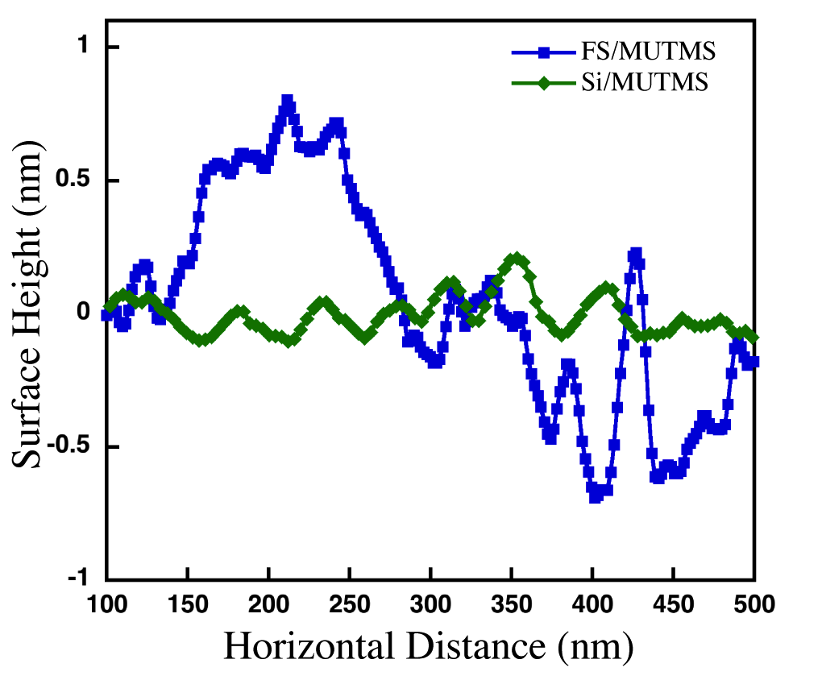
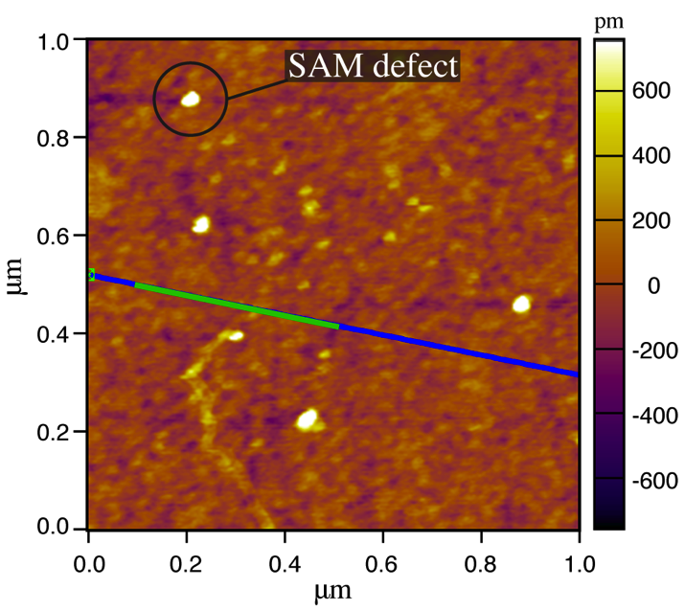
Surface Roughness: Si vs. Fused Silica
AFM Scans
FS/MUTMS
Silicon provides lower roughness (1.2 Å) substrate surface than FS (7.4 Å)
Spallation strength of MUTMS
on Si: ~ 200 MPa
on FS: ~ 85 MPa
Si/MUTMS

Slide 18


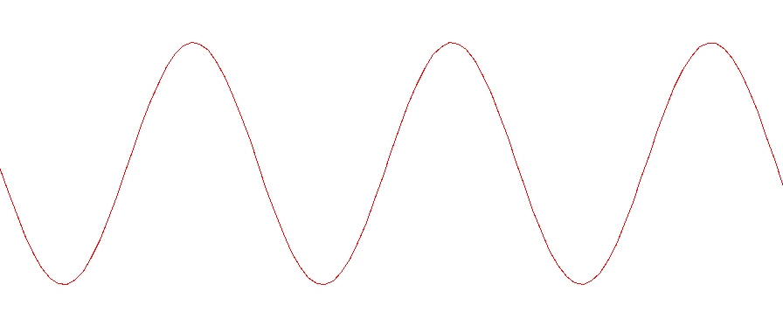

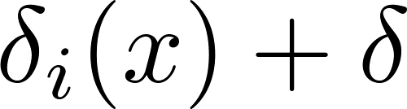
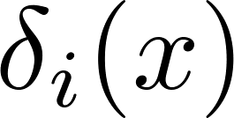
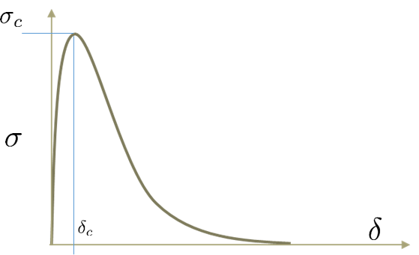
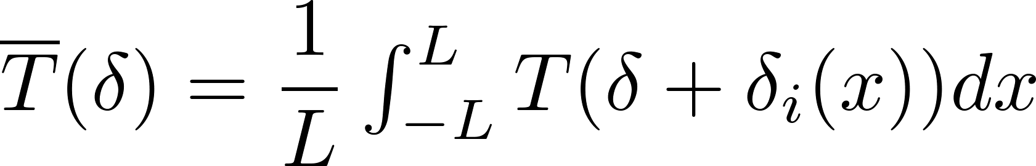

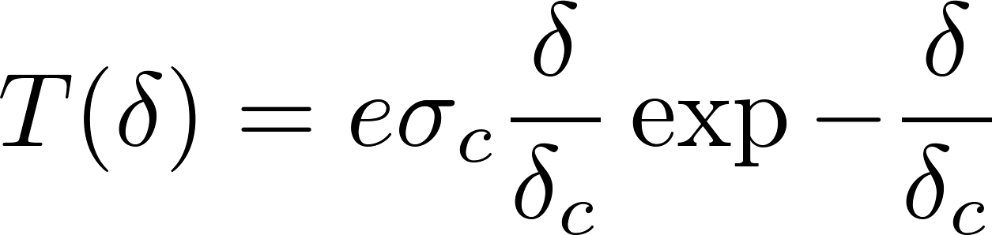
Rigid/Static Separation: 1D Mesoscale Model
Au
SAM
surface
2A
L (>>A)
Effective cohesive traction
Same length scale:
SAM thickness
surface roughness
MD cutoff radius
where

Slide 19
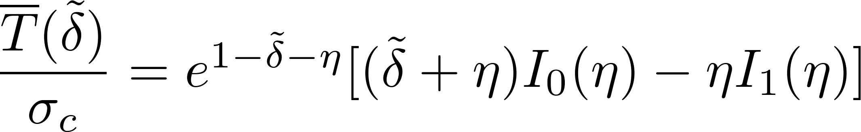
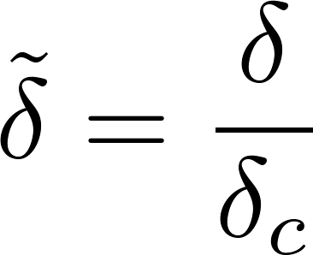
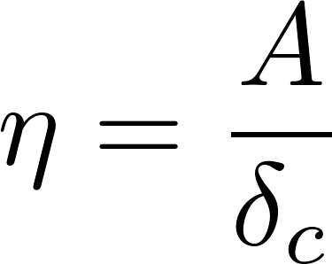
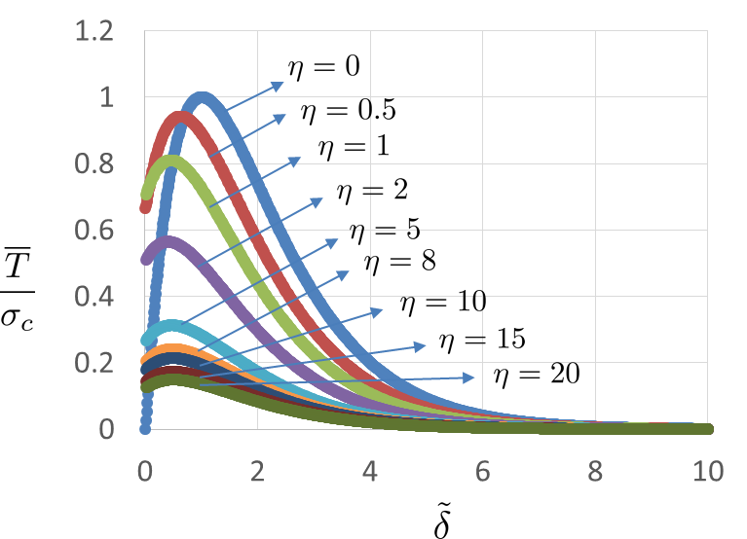
Rigid/Static Separation: 1D Results
where

Slide 20




Rigid/Static Separation: 2D Results
For the current system,
Incorporation of surface roughness significantly reduces average cohesive traction

Slide 21















Deformable Film Model
Governing Differential Equation
From MD Simulations
Boundary Conditions
Notes:
21

Slide 22









Non-dimensional Equations
Governing
Differential
Equation
Boundary Conditions
Non-dimensional
Parameters
Typical thin film substrate system
Notes:
22

Slide 23
















Initial Profile & Bending Energy
Notes:
23

Slide 24














Initial Profile & Bending Energy
Notes:
24

Slide 25














Initial Profile & Bending Energy
Notes:
25

Slide 26


Bending Energy vs. (β , η)
Notes:
26

Slide 27





Spallation: Quasi-Static Model
“Rigid Spallation” : spallation process too fast for dynamic bending effect to take place
Notes:
27

Slide 28




















Effective Cohesive Law
Notes:
28

Slide 29

















Effective Cohesive Law
Notes:
29

Slide 30
















Effective Cohesive Law
Notes:
30

Slide 31


Effect of Roughness on Cohesive Energy
Notes:
31

Slide 32





Conclusions and Current/Future Work
Interfacial strength of SAM-mediated interfaces strongly dependent on functional group chemistry
MD simulations point to drastic difference in strength and work of separation between methyl and thiol terminated SAMs
Incorporation of surface roughness critical in obtaining effective cohesive properties
Current/Future Work
MD simulations of correlation between failure and thermal properties
Dynamic analysis of impact of roughness on failure properties
Effect of randomness
‘3D real surfaces’
Delamination of SAM-enhanced interfaces

Slide 33
Thank You
Grady, M. E., Geubelle, P. H., Braun, P. V., and Sottos, N. R. (2014) “Molecular tailoring of interfacial failure.” Langmuir. DOI: 10.1021/la502271k.
Philippe H. Geubelle
Aerospace Engineering and Beckman Institute
University of Illinois Urbana Champaign
306 Talbot Laboratory 104 S Wright St. Urbana IL 61801
geubelle@illinois.edu

